Slide 1
Rafiq Mohammadi, General Manager, Promote

Slide 2
An introduction to Autonomy IDOL: technical essentials
Rafiq Mohammadi, General Manager, Promote
December, 2012

Slide 3

Enterprise trends in human information
“Digital information will grow by a factor of 44, to 35 ZB in 2020.”
IDC
“Increased blurring of internal and external data in organisations.”
IDC
“By 2014, social networking will replace email for 20% of business users.”
Gartner
Notes:
No slowdown in sight. There are 126M blogs, 4B photos hosted on Flickr alone, there are 500M active Facebook accounts. These numbers, considering the immaturity of the market, are absolutely astronomical.

Slide 4
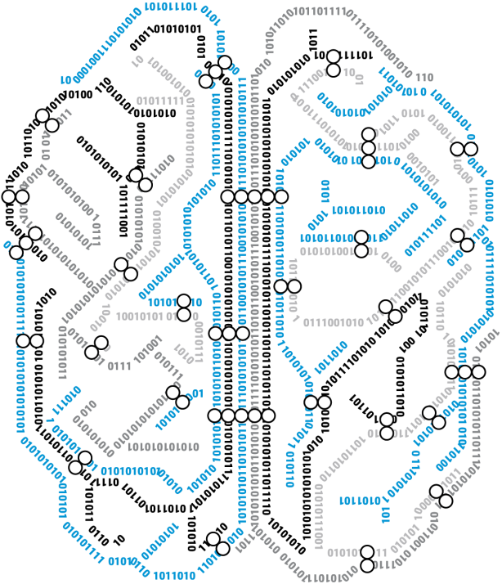
IDOL: the OS for human information
Algorithms and 170 patents
Conceptual technology – open architecture SOA ACI XML
One platform for all functions – no Frankenstein’s Bride
One platform for all data types - audio, video, unstructured, XMLs and structured data
Cutting-edge technologies
Implicit query, audio and video search, clustering, etc.

Slide 5














IDOL architecture
Big data & analytics
Search & collaboration
Information governance
Customer experience mgmt
Marketing optimisation
Autonomy
Social Media
Video
Audio
Email
Texts
Mobile
Transactional
Data
Documents
IT/OT
Search Engine
Images
Over 400 Connectors
Unstructured repositories
Databases
Mail servers
CRM/ERP/BI
LDAP

Slide 6
Over 500 IDOL functions
2D/3D Clustering
Acoustic signature
Active matching
Agents
Alerting
Auto language detection
Auto query guidance
Boolean & legacy
Operations
Breaking news clustering
Categorisation
Collaboration
Community
Concept highlighting
Concept-query
Summarisation
Conceptual retrieval
Context summarisation
Cross-modal suggest
Dynamic n-dimensional
Taxonomy generation
Dynamic XML Consumption
Eduction
Exact phrase matching
Expertise location
Explicit profiling
Face recognition
Field modulation
Frame analysis
Fuzzy matching
Hot clustering
Hyperlinking
Image analysis
Image association
Implicit profiling
Keyword search
Mail object identification
Melody classification
Melody identification
Metadata recognition
Natural language retrieval
Object identification
Object recognition
Ontology generation
Parametric refinement
Phrase spotting
Proper name identification
Query by example
Real-time aggregation
Routing
Scene detection
Script alignment
Sentiment analysis
Soundex matching
Speaker identification
Speaker recognition
Spectographic analysis
Spell checking
Tag reconciliation
Transcription
Video analysis
Voice printing
Word spotting
Work groups
XML tagging
Notes:
Over the years we have developed a complete platform to process unstructured information.
500 functions, from pretty basic keyword search, to more complex clustering, sentiment analysis, or speech to text.
400 connectors to connect to pretty much any kind of repository, from file systems, to content managemetn systems, databases and the web.. We can understand more than 1,000 file types.

Slide 7

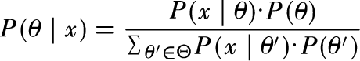

A fundamentally different approach
Applying mathematical analysis provides insight and meaning to all forms of data
Context during retrieval is used to provide context-accurate data and analysis
Deep analysis and discovery tools to locate and see trends in data sets
Information Theory and Bayesian Inference
Integration through
understanding

Slide 8
Keywords and metadata do not solve the problem
Strong deterministic words used for retrieval of information
Common words like articles or conjunctions are dismissed leaving only “keywords”
Boolean rules complicated
Limited to what you know
“The dog and the cat run away”
“dog cat run away”
( Apple AND computer ) tree ) Macintosh OR ( Jobs Steve )

Slide 9
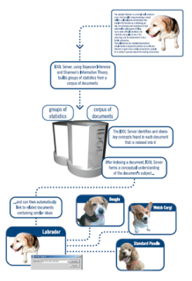

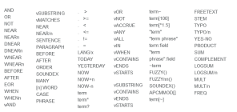
Autonomy retrieval methods
Ferrite
Aluminium
Conceptual
Natural language
Conceptual matching
Unstructured refinement
Business rules
Boolean
Keyword
Parametric
Structured refinement
Structured
Magnesium
Ferrite AND (aluminium OR magnesium)
Notes:
IDOL server offers the following basic legacy search methods:
Legacy Keyword
IDOL server accepts a keyword and returns a list of documents containing the terms ordered by contextual relevance to the query.
Boolean/ bracketed Boolean
IDOL server accepts simple or complex Boolean and bracketed Boolean expressions and returns a list of matching
documents. Boolean expressions can be formed using a range of Boolean and proximity operators: • AND, • NOT, • OR, • XOR / EOR, • NEAR, • DNEAR, • WNEAR, • BEFORE, • AFTER
Exact Phrase
Provides the ability to search for exact phrases by putting quotation marks around a string of words. For example:
“world market”
Fuzzy Queries
If a search string is not quite accurate (for example, if it contains spelling mistakes) a fuzzy query returns results that
contain words that are similar to the entered string. (Note that you need to enable fuzzy queries before you can use them).
Proximity Search
IDOL server returns documents in which specific terms occur within a given proximity with a higher weighting.
Soundex Keyword Search
If the spelling of a keyword is not quite accurate but phonetically correct a Soundex keyword search returns results that contain the keyword and phonetically similar keywords (using a configurable Soundex algorithm).
IDOL server provides the following sophisticated conceptual retrieval operations:
Conceptual matching
IDOL server accepts a piece of content (a sentence, paragraph or page of text, the body of an e-mail, a record containing human readable information, or the derived contextual information of an audio or speech snippet) or reference (identifier) as input and returns references to conceptually related documents ranked by relevance, or contextual distance. This is used to generate automatic hyperlinks between pieces of content.
Active Matching
IDOL server accepts textual information describing the current user task and returns a list of documents ordered by
contextual relevance to the active task.
Proper Names
IDOL server recognizes names and treats them as a unit.
Retrieval - Parametric
Advanced Parametric Refinement is used to provide an improved user experience coupled with increased productivity via an advanced real time information discovery process. Real time navigation across multiple taxonomies is supported with no additional manual configuration necessary, including full access to intersections of diverse taxonomy definitions. From among the complete set of field names present within the corpus, a subset of fields can be defined in the server’s configuration as of type 'Parametric'. These fields are known as 'parametric' fields.
Once indexed, IDOL server will create and store a structure containing information about all 'tag-value' pairs that occur
within defined parametric fields ('tag-value's' are defined where a field contains a textual or numerical value and the
field name is considered paired to its textual value) The user may then query IDOL server with the name of a
parametric field or fields. IDOL server returns a list of all textual values that appear within the given field or fields
within the documents stored in the server. This underlying operation can be used to power a user interface that enables a user to gradually refine the scope of query from a complete corpus to the subset of documents that contain information pertinent to the user's current enquiry.
Retrieval - Federated
Submit queries to a selection of third party search engines in addition to IDOL server, e.g. Google, Yahoo, alltheweb etc.

Slide 10

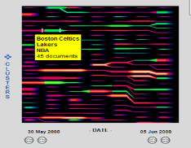
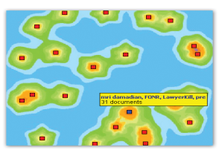
Side letters
Off balance sheet
transactions
Product performance issues
Clustering
AUTOMATICALLY partition the data so that similar information is clustered together
Notes:
PIC5 (grouped documents)
"So for example we might see groups based on off-balance sheet trading entities... side letters.... product performance issues.... procurement failures.... and even sub-sets of these concepts and relationships such as one of our customer found, which was employees using credit cards to order items that procurement failures forced them to do themselves!

Slide 11
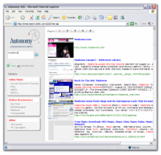
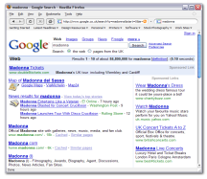
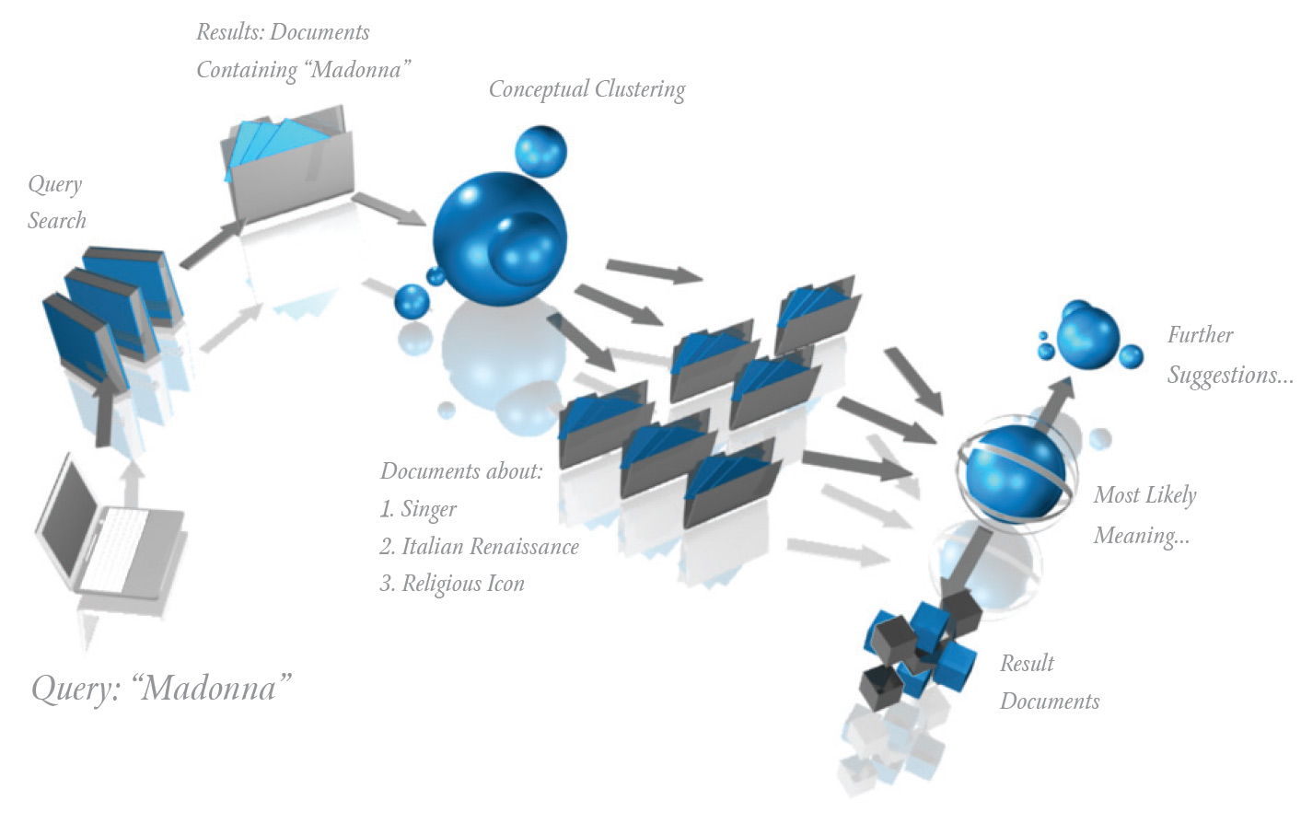
Automatic Query Guidance
Significantly superior to page rank in the enterprise
Automatic
Requires no set up
Designed for unfamiliar users
1-2 word queries

Slide 12








Hyperlinking
Video
Voice/audio
Mobile/ PDA
XML
Tacit knowledge
Social
File system
Desktop
Internet/ webpages
Document management
Relational database
Email server

Slide 13

Classification
Open philosophy
Automatic with full user control
Best of all worlds
Train by example
Clustering
Existing taxonomy
Automatic taxonomy generation
Boolean, business rules
Tailored taxonomy services
Notes:
“Taxonomic classification is the action of placing an object into a set or sets of categories (such as a taxonomy or a subject index), based on the properties of the object or concept.”

Slide 14

Language independence
Based on statistical probabilistic processing
Supports 150+ live customer languages
Single, double byte and unicode languages
Operates independent from linguistic restraints and rules
Functions work cross-lingual
Optional language packs for localisation
Afrikaans
Albanian
Arabic
Armenian
Azeri
Basque
Belorussian
Bengali
Bosnian
Breton
Bulgarian
Burmese (Myanmar)
Catalan
Cherokee
Chinese (simplified)
Chinese (traditional)
Croatian Czech
Danish
Dhivehi (Thaana)
Dutch
English
Esperanto
Estonian
Ethiopic
Faroese
Finnish
French
Frisian
Gaelic
Galician
Georgian
German
Greek
Greenlandic
Gujarati
Hausa
Hebrew
Hindi
Hungarian
Icelandic
Indonesian
Italian
Japanese
Kannada
Kazakh
Khmer
Korean
Kurdish
Kyrgyz
Isan
Lappish
Latin
Latvian
Lithuanian
Luxembourgish
Macedonian
Malay
Malayalam
Maltese
Maori
Mongolian
Ndebele
Nepali
Norwegian
Oriya
Panjabi
Pushto (Pashto)
Persian (Farsi)
Polish
Portuguese
Romansch (Rhaeto)
Romanian
Russian
Sami
Serbian
Sesotho
Sesothosaleboa
Sinhala (Singhalese)
SiSwati (Siswant)
Slovak
Slovenian
Somali
Sorbian
Spanish
Syriac
Swahili
Swedish
Tagalog
Tajik
Tamil
Tatar
Telugu
Thai
Tibetan
Tsonga
Tswana
Turkish
Ukrainian
Urdu
Uyghur
Uzbek
Venda
Vietnamese
Welsh
Xhosa
Notes:
14
Main Point: IDOL is fundamentally predicated on a language independent model.
Functionalities:
IDOL treats words merely as abstract symbols of meaning, forming a contextual understanding based on probabilistic modelling as opposed to requiring language-dependent parsing or dictionaries to form ideas
112 languages can be configured to automatically detect the language of incoming documents
IDOL’s Sentiment Analysis uses linguistic analysis on an intra-document level to determine the degree to which a sentiment is positive, negative or neutral (e.g. Call Centre Management, AU Explore, Social Media Analyis)
Main Commercial Advantages:
As companies increasingly go global, it’s important to leverage intellectual assets from all offices worldwide a) to avoid duplication of effort b) for compliance c) to harness expertise - IDOL delivers these automatically
Linguistic sentiment analysis enables companies to understand in near real-time the sentiment of what their employees/customers are saying about them in social media, and what is being said about them in the news

Slide 15
Social: agents and profiling
Explicit profiling (agent):
“User definition”
Define your interest using:
Natural language descriptions
Keyword/ Boolean rules
Refine by example
Automatically monitor information
Customisable
Implicit Profiling:
“Capturing behaviour”
Share your interests using:
Fully automated and dynamic profiles
On-going monitoring of data consumption
No refinement
Multi-faceted profiles
Always up-to-date
Notes:
Personalisation is the facility to automatically allow users to customise the INFORMATION they see when they use an Autonomy based system. Typically this is confused with customisation of the interface they see. While interface customisation is nice to have, INFORMATION personalisation is what makes a service or web site useful as opposed to aggrevating. Autonomy applications allow their users to create their own explicit ‘interest channels’ These are created in a very user friendly way - either thru natural language descriptions of what is of interest, example content (point and click) or if preferred thru keywords or boolean expressions. In every case the user always has a simple mechanism of refinement: BY EXAMPLE - removing the need for users to go back and attempt to edit boolean rules to filter content they do not have an interest in.
The explicit personalisation agents are often used in applications to provide users with facilities to find, monitor and be alerted to information about their own personal interest areas. In addition, agents can be used to find other agents - allowing users to find other users with similar interests, working on the same problems or with the same information.
Implicit agents are used in Autonomy based applications to generate a PROFILE of users interests. Again, this is an automatic process that can be enabled or disabled thru configuration. The system tracks the content a user interacts with and extracts a conceptual understanding of each piece of content. It then builds and maintains a multi-faceted ‘profile’ of the user. This then represents a very CURRENT understanding of the users interests with no need for explicit input of any form from the user.
Typically profiling is used to allow systems to target information to particular users, recommend content to users who may be interested, alert users to the existence of content. All this is AUTOMATIC and can often be used to provide information to users that they may not have thought to look for.
Because Autonomy provides an infrastructure (more later) profiling can take place across multiple devices. A profile generated thru a user’s interaction with WAP content for example can then be sued to recommend internet content on the Web or news content via email or SMS.

Slide 16

Mapped security
Fully integrated Kerberos authentication together with Secure Socket Layer (SSL) encryption across all transactions
Compliance with all major Security Standards, including US DoD5015.2, UK TNA2002, Australia’s VERS, ISO 15489
Fully mapped security all ACL based access control
Full-range of customisable security functionality, including:
Discretionary access control (ACL based)
Mandatory access control (Based on Meta Data)
Kerberised access to IDOL
Allows SSO authentication using Windows Active Directory
Single supplier to US Department of Homeland Security
Notes:
Main Point: IDOL is a secure piece of software, compliant to all major Security Standards with a range of fully mapped security features.
As a result, Autonomy is trusted with 17 petabytes of information from leading banks, law films and defence agencies worldwide.
The world’s largest and most secure intelligence organisations have deployed Autonomy’s Intellectual Asset Protection System (IAS) to safeguard their most sensitive information assets. For example, Autonomy is the sole supplier to the US Department of Homeland Security.

Slide 17

Rich media support
Video is “watched and listened to”
Metadata automatically created
Key frames created providing a unique understanding of each frame
Speech to text allows for accurate synchronisation and re-use
Automatically understand video footage and audio streams
Advanced analytics can be applied to video and audio components
User generated content can be associated to other assets allowing for the “long-tail” to be captured
Rich media assets can be clustered, categorised and linked to other electronic information of all types
Deliver the right information, to the right person, at the right time

Slide 18

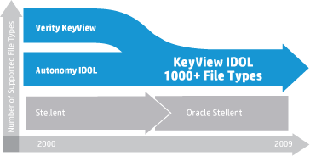






KeyView technology
“KeyView IDOL Filter and Export SDKs offer superior overall performance and robustness. Further, we felt the technical support was second to none.”
Support for 1,000+ file formats
Used heavily in Autonomy content, archiving and records management
Used by virtually every major software sector and competitor, 400+ OEM agreements
Hundreds of millions of installs
Notes:
Main Point: IDOL has a unique connectivity, with native support to 400+ repositories and 1,000+ file formats.
This beats all our software peers, and indeed it is the case that they all need to OEM elements of our software, e.g. Oracle, IBM, SAP etc.
IDOL integrates with all known legacy systems, eliminating the need for organizations to cobble together multiple systems to support their disparate components

Slide 19
The next generation of data analysis

Slide 20

IDOL and Vertica
Ideal software engines for big data
Processing for structured and unstructured data
Connecting to hundreds of data sources
Blazing fast and deep analytics
Pattern-matching technology recognises concepts and trends in human friendly information
Benefits: dramatic business impact
Uncover revenue opportunity
Tap in to new signals of risk
Minimise cost and complexity
Over 400 Connectors

Slide 21



How it all works
Q
SELECT * FROM WINE WHERE GRAPES = 'merlot' AND CONCEPT = 'fruity wines that are good with lamb'
From a database get me all matches from the table called “wine” which has within the column “grape” a value of “merlot”
From unstructured sources get me all matches for wines which match thee criteria 'fruity wines that are good with lamb'
A
Structured Data
Unstructured Data

Slide 22

Success depends on understanding all forms of information
…unstructured and structured

Slide 23

Summary
IDOL provides one platform for all functions and powers all Autonomy HP products
Trusted and proven with the most demanding global customers
Significant ROI through automation
Greater control, access and management of information
“Autonomy's IDOL solution is the most complete product evaluated with the best core technology architecture and security capabilities.”
Forrester

Slide 24

Download Now
Get the Mobile App
Download content from this session with the free Mobile App at:
m.hp.com/events

Slide 25
Find out more
Attend these sessions
Visit these demos
After the event
BB2801, Autonomy IDOL: unify your business on one information management platform Thursday, December 6, 9:30-10:15
BB1788, Big data and customer analytics: cracking the code to find hidden value Thursday, December 6, 11:30-12:15
Autonomy IDOL, Demo #746
HP Autonomy Legal and Compliance Performance Suite, Demo #612
HP Autonomy Marketing Performance Suite, Demo #613
Visit : www.autonomy.com
Follow us on Twitter: @AutonomyCorp
Also on LinkedIn: Autonomy, an HP Company
Like us on Facebook: Autonomy, an HP Company
Your feedback is important to us. Please take a few minutes to complete the session survey.

Slide 26
Thank you

Slide 27
声明：
所有的版权属于原有公司，文件均来自公开渠道
此文件仅供学习使用，任何人不得进行以此为商业目的的行为
如有疑问，请立即删除
学习世界五百强和咨询公司PPT课程请访问如下网站搜索：“司马懿”
百度传课：司马懿PPT学校
网易学堂：司马懿PPT学校
知乎： 司马懿PPT学校
访问地址
https://www.chuanke.com
访问地址
https://study.163.com
访问地址
https://www.zhiu.com

